Slide 1
Airbnb Data Challenge
Understand data
Key metrics to monitor guest-host matching success
Feature engineering & Model building
Segments doing well v.s. not well
Opportunities in increasing the number of successful bookings
Challenges of matching supply and demand
Additional research methods
Notes:
Title less technical

Slide 2
Understand Data

Slide 3
Overview of Datasets
Contacts:
There are 27,887 unique inquiries with 11,588 bookings, 14 variables
Inquiries are made through 3 channels: Contact me, Book it, and Instant book
The inquiry time varies from 01/01/2016 to 06/30/2016, lead time of these inquiries ranges from 0 - 803 days
The check in dates varies from 01/01/2016 to 05/01/2018, and length of stay ranges from 1 - 365 days
Inquiries are made by either new bookers or past bookers for 1 - 16 guests
The total number of interactions between guest and host ranges from 1 - 410
Listings:
There 13038 unique listings with 4 variables
There are 3 room types for listings: Entire home/apt, private room and shared room
Listings are located in 68 neighborhoods
The number of reviews for listings ranges from 0 -268
Users:
There are 31457 users after dropping 68 duplicated ones, with 3 variables
Users are from 121 unique countries with profile length ranges from 0 - 1442

Slide 4
Sanity Check - Assumptions
Contacts
Inquiry/reply/accept/book timestamps:
ALL channels:
Inquiry time ≤ reply time ≤ accept time ≤ book time
All accepted inquiries must be replied
All booked inquiries must be accepted
Check in time ≤ check out time
Book it:
Accept time = book time
Instant book:
Inquiry time = reply time = accept time = book time
Guest size ≥ 1, total number of interactions ≥ 1, and message length ≥ 0
Listings:
Number of reviews ≥ 0
Users:
No duplicated users
Profile length ≥ 0

Slide 5
Sanity Check - Observations and Treatments
Contacts
Inquiry/reply/accept/book timestamps:
ALL channels:
452 inquiries where the inquiry time > reply time with lags between 1-70 seconds
Updated the reply time to be the same as inquiry time
Book it:
257 inquiries accepted but not booked,
Updated the book time to be the same as accept time
152 inquiries where booked but not accepted or book time ≠ accepted time
Updated the book time to be the same as accept time
Instant book:
40 inquiries where inquiry, reply, accept, and booking did not happen at the same hour (allowed the latency of an hour)
Filtered out these inquiries assuming they are erroneous records

Slide 6
Sanity Check - Observations and Treatments (Cont.)
Contacts:
Guest size:
4 inquiries where number of guests is 0:
Filtered out these inquiries assuming they are erroneous records
Listings:
Number of reviews:
41 listings with negative number of reviews:
Replaced with medium
Users:
Duplicates:
68 users with duplicate ids:
Remove from analysis

Slide 7
Merge Data
Guest information:
Merged guest information from ‘Users’ to ‘Contacts’, by ‘id_guest_anon’ in ‘Contacts’ and ‘id_user_anon’ in ‘Users’
Host information:
Merged host information from ‘Users’ to ‘Contacts’, by ‘id_host_anon’ in ‘Contacts’ and ‘id_user_anon’ in ‘Users’
Listing information:
Merged listing information from ‘Listings’ to ‘Contacts’, by ‘id_listing_anon’ in both datasets

Slide 8
Overview of Data After Cleaning
Before/After | Inquiries | Replied | Accepted | Booked
Contact me | 12,828/12,814 | 11,659/11,645 | 5,482/5,476 | 911/909
Book it | 8,366/8,352 | 7,503/7,492 | 4,240/4,237 | 3,983/3,980
Instant book | 6,693/6,682 | 6,693/6,682 | 6,693/6,682 | 6,693/6,682
Total | 27,887/27,848 | 25,855/25,819 | 16,415/16,395 | 11,587/11,571
27,848 valid inquiries were made by 22,540 unique guests
The inquiry time varies from 01/01/2016 to 06/30/2016
Inquiries were made for 12,812 unique listings of 8,956 unique hosts

Slide 9
Key metrics to monitor guest-host matching success

Slide 10
Key metrics to monitor guest-host matching success
Success rate
Success rate = # successful bookings / # total inquiries
This metric monitors the overall performance of the booking funnel
Reply/acceptance rate/booking rate
Reply rate = # inquiries replied/# total inquiries
Acceptance rate = # inquiries accepted/# replied inquiries
Booking rate = # inquiries booked/# accepted inquiries
These metrics help track the success rate of each steps of the booking funnel
Average interactions per inquiry
Avg interactions per inquiries = # total interactions / # total inquiries
By monitoring this metric, Airbnb can be proactively encourage interactions between hosts and guests when needed, since interaction the most important driver of acceptance and booking according to model results
Review rate
Review rate = # inquiries that the guest left a review / # total inquiries
By monitoring this metric, Airbnb can be proactively improve reviews for listings when needed in that number of review which highly impact reply and booking according to model results
Demand fulfilment ratio
Total duration of stay in all inquiries/ # total days available for all listings
By monitoring how much of users’ demand is being is fulfilled, Airbnb can proactively resolve the imbalance in supply and demand

Slide 11
Feature engineering
&
Model building

Slide 12
Feature Engineering
Independent variables from dataset:
Number of interactions
Number of reviews
Channel
Lead time
Days of stay
Guest size
Room type
First message length
User stage
Reply time
Accept time
Interaction variables created:
Number of interactions * Lead time
Number of interactions * Days of stay
Channel * Lead time
Channel * Days of stay
Channel * Room type
Lead time * Message length
Guest size * Room type

Slide 13
Model Building
 | Reply | Acceptance | Booking
Sub dataset | All inquiries in Contact Me & Book It channel | All replied inquiries in Contact Me & Book It channel | All accepted inquiries in Contact Me channel
Features | Left out variables related to number of interactions (highly indicative) | Add independent variable reply time | Add independent variable accept time
Class weights | Add 10% more weight on not replied inquiries | / | Add 10% more weight on not booked inquiries

Slide 14
Model Building
Model type | Logistic regression
Collinearity | Regularized with ‘L2’ penalty
Feature selection | Removed features with coefficient of 0 when using ‘L1’ penalty
Cross validation | Used sklearn.model_selection.GridSearchCV to find the best hyperparameter value
Sampling method | Used stratified sampling in train/test split and cross validation

Slide 15
Model results - What impacts reply?
Significant Features | Coefficient
reviews_>30 | 0.355
contact_me | 0.267
reviews_11-20 | 0.2322
reviews_0 | -0.6224
message_length_0-150 | -0.1788
reviews_1-10 | -0.1344
lead_time_>90d | -0.1183
Inquiries for listings with more reviews are more likely to be replied
Inquiries made in Contact Me channel are more likely to be replied than in Book It channel
Hosts are less likely to respond to first messages with less than 150 characters
Inquiries made too far ahead of check-in are less likely to be replied

Slide 16
Model results - What impacts Acceptance?
Having more than 20 interactions increases the chance of acceptance and having less than 10 interactions decrease it
Inquiries for listings with more reviews are more likely to be accepted
For inquiries made more than 90 days ahead, using Contact Me channel increase its chance to be accepted
For inquiries made more than 90 days ahead, having less than 10 interactions decreases their chance to be accepted
For inquiries with duration between 1- 5 days, having less than 10 interactions decreases their chance to be accepted
Significant Features | Coefficient
interactions_>30 | 0.5806
interactions_21-30 | 0.5122
reviews_>30 | 0.471
contact_me*lead_time_>90d | 0.4061
interactions_1-10 | -1.1965
reviews_0 | -0.8542
lead_time_>90d*interactions_1-10 | -0.6393
days_of_stay_1-5d*interactions_1-10 | -0.5807

Slide 17
Model results - What impacts Booking?
Significant Features | Coefficient
interactions_>30 | 0.9256
interactions_21-30 | 0.6503
past_booker | 0.5745
message_length_151-300*interactions_>30 | 0.4228
interactions_1-10 | -1.7255
lead_time_>90d*interactions_1-10 | -0.6576
message_length_0-150*interactions_1-10 | -0.5106
days_of_stay_>15d | -0.5073
Having more than 20 interactions increases the chance of booking and having less than 10 interactions decrease it
Paster bookers are more willing to book make the booking when their inquiries is accepted
When first message length is between 151 - 300 characters, having more than 30 interactions increases the inquiry’s chance to be booked
For inquiries made more than 90 days ahead, having less than 10 interactions decreases their chance to be accepted
When first message length is between 151 - 300 characters, having more than 30 interactions increases the inquiry’s chance to be booked
Inquiries for stays over 15 days are less likely to be booked

Slide 18
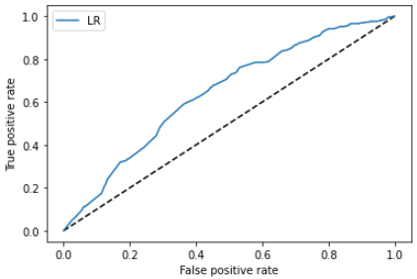
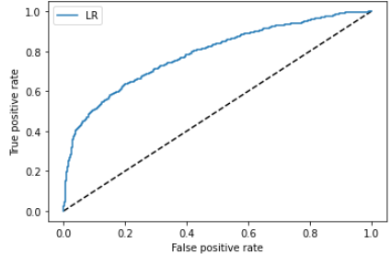
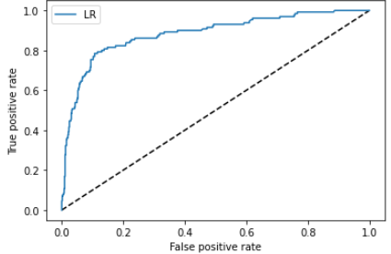
Model performance
 | Reply | Acceptance | Booking
Accuracy | 88% | 77% | 89%
ROC curve
AUC score | 0.64 | 0.79 | 0.88

Slide 19
Opportunities in increasing the number of successful bookings

Slide 20
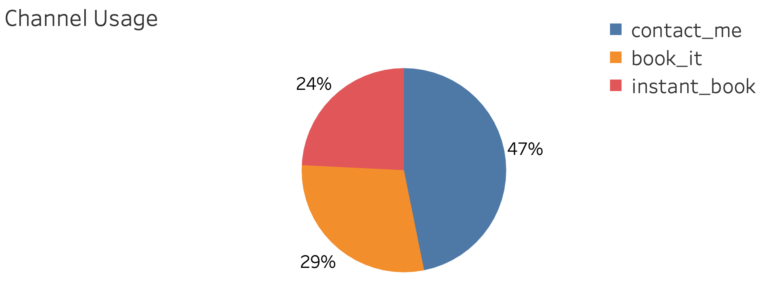
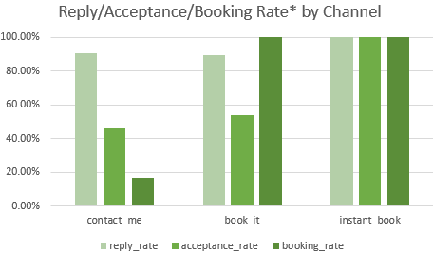
Finding - Channels
Almost half (47%) of the inquiries are made through Contact Me, but booking rate(17%) in Contact Me channel is the lowest
Successful booking via Contact Me:
81% of the booked inquiries had over 10 interactions.
85% of the booked inquiries had first message longer than 50 characters

Slide 21
Opportunity - Channels
Channel Selection:
Encourage users to user Book It or Instant Book channel
Encourage hosts to opt-in to Instant Book channel
Guests chose Contact Me channel:
Encourage guests to leave messages over 50 characters
Encourage interactions between guests and hosts, preferably over 10

Slide 22
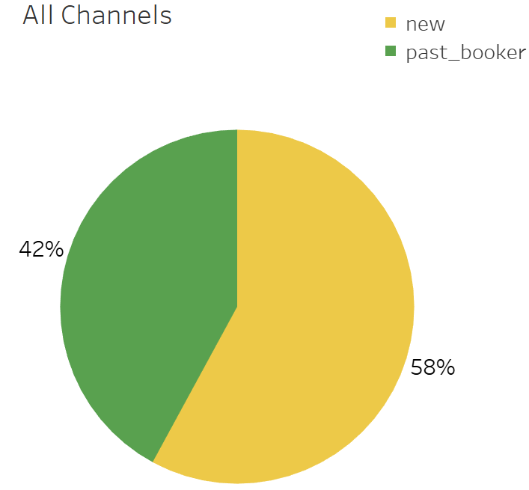
Finding - User stages
Almost 60% of the users are new users, but 55% of them chose Contact Me channel and have a low booking rate
[# of inquiries] reply/accept/book rate* | Contact Me | Book It | Instant Book
New Booker | [8,793] 91%/46%/15% | [4,296] 89%/52%/100% | [2,802] 100%/100%/100%
Past Booker | [4,005] 90%/47%/22% | [4,050] 90%/56%/100% | [3,881] 100%/100%/100%
Successful booking for new users:
15% booking rate in Contact Me v.s. 52% in Book It
83% of the booked inquiries in Contact Me had over 10 interactions

Slide 23
Opportunity - User stages
Encourage new users to make inquiries in Book It or Instant Book channel
Encourage interactions between guests and hosts if the guests chose Contact Me already
Give hosts credit for opt-in for Instant Book Channel
Provide introduction videos for guests to teach them how to use Book It and Instant Book channel

Slide 24
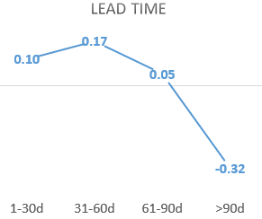
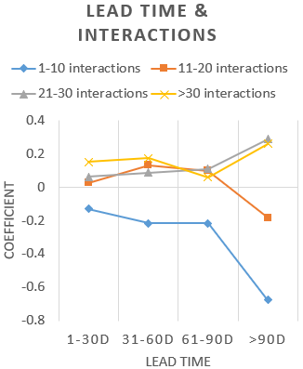
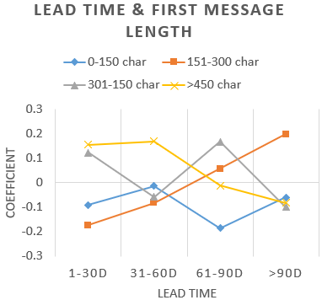
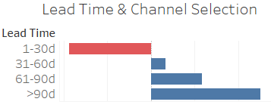

Finding - Long lead time
Model results for acceptance
Model results for booking
Inquiries made more than 90 days ahead are likely to be rejected by the hosts, but 35% of the inquiries had lead time > 90 days
Successful booking for inquiries with long lead time:
Having more than 20 interactions increases the acceptance rate
Making inquiries in Contact Me channel increases the acceptance rate
Sending first messages 151-300 characters increases the booking rate

Slide 25
Opportunity - Long lead time
If guests make inquiries more than 90 days ahead of check-in:
Encourage guests to use Contact Me channel
Encourage guest to send first message between 151- 300 characters
Encourage interactions between guests and hosts

Slide 26
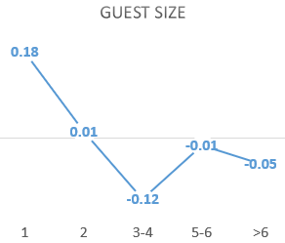
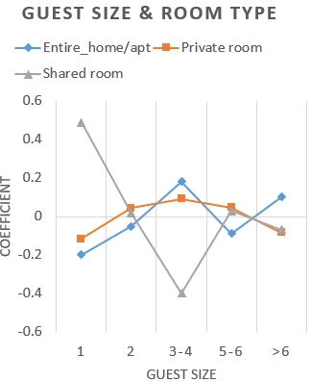
Finding - Guest sizes
Model results for acceptance
43% of the inquiries are for over 3 guest, whereas guest sizes over 3 decreases acceptance rate according to model results
Successful booking for inquiries for over 3 guests:
67% of the booked inquiries were made in Book It channel or Instant Book channel
Inquiries for room type of Entire home/apt have higher chance to be accepted

Slide 27
Opportunity - Guest sizes
If guests make inquiries for over 3 guests:
Encourage guests to use Book It channel or Instant Book channel
Recommend guest to choose Entire home/apt as room type

Slide 28
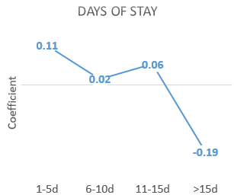
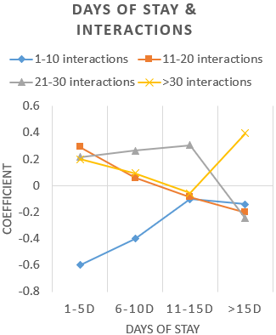
Finding - Long duration of stay
Model results for acceptance
Inquiries made for more than 15 days of stay (10% of the inquiries) are likely to be rejected by the hosts
Successful booking for inquiries with long duration of stay:
Having more than 30 interactions increases the acceptance rate

Slide 29
Opportunity - Long duration of stay
If guests make inquiries more than 15 days of stay:
Encourage interactions between guests and hosts so that hosts can be more comfortable accepting the inquiries

Slide 30
Segments doing well v.s. not well

Slide 31
Segments doing well v.s. not well
Segments doing well:
Past Booker:
Success rate 53%
Average # interactions per inquiries 9
Instant Book channel:
Success rate 100%
Average # interactions per inquiries 11
Listing with 30+ reviews:
Success rate 73%
Average # interactions per inquiries 9
Not well:
New Booker:
Success rate 33%
Average # interactions per inquiries 8
Contact Me channel:
Success rate 7%
Average # interactions per inquiries 6
Listing with 0 reviews:
Success rate 28%
Average # interactions per inquiries 6

Slide 32
Recommendations

Slide 33
Recommendations
Use Instant Book channel
Encourage guests to use instant book channel and hosts to opt-in for Instant Book channel
If the hosts is opt-in for Instant Book channel, encourage users to use Book It channel
Encourage interactions between hosts and guests
High interactions can compensate for characteristic of inquiries that negatively impact success rate
Interactions can also encourage guests to leave a review after their stays
Encourage guests to leave a review after completing their trips
More reviews drives all three steps of booking funnel from reply to booking
Give credit to guests who left a review for new listings so that hosts are more encouraged to accept inquiries as well

Slide 34
Challenges of matching supply and demand

Slide 35
Challenges of matching supply and demand
Seasonal impacts:
Since Airbnb is a vacation rental platform, there can be complex seasonalities in both demand and supply, which would affect the success of matching them
Regional impacts:
Guests can have different preference over different regions, which might be due to security issues, commuting time, etc.
Pricing:
Hosts may find it challenging to set the most appropriate price for their listings according to the condition of their property or the price of similar listings.

Slide 36
Additional research methods

Slide 37
Additional research methods
Can carry out researches to find a pricing model that could advise the hosts based on the characteristics of their listings and seasonalities.
Can design A/B tests to find most functionalities in channel selection, interacting pages and reviews buttons that maximizes success rate.

